Slide 1
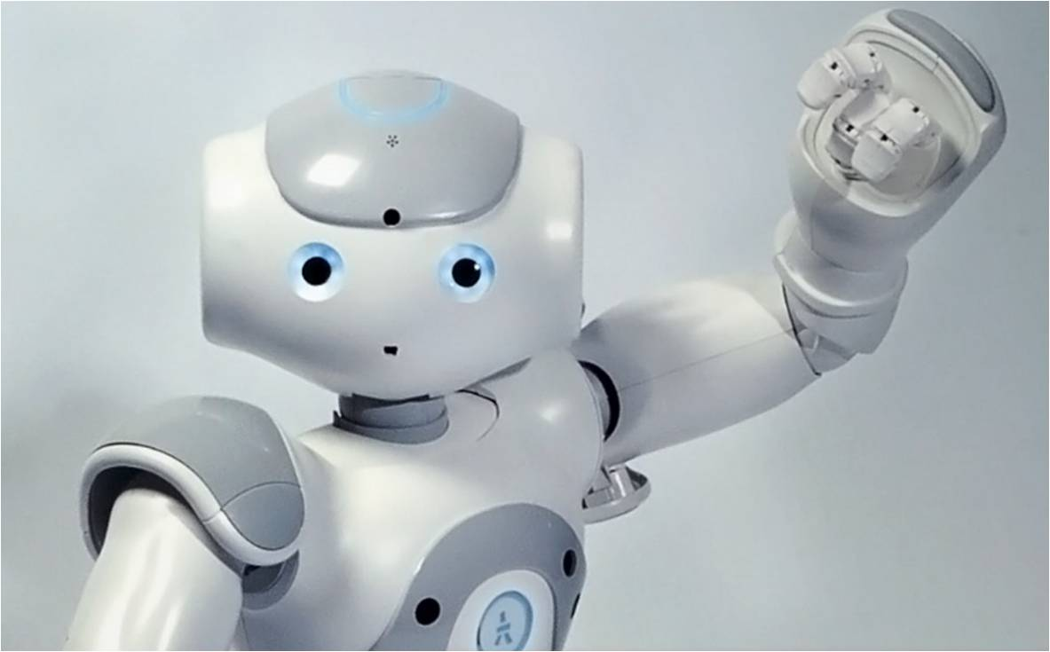
Simultaneous Localization and Mapping on NAO
Taghi Aliyev
Dennis Soemers
Roel Strolenberg
Gabrielle Ras

Slide 2
Outline
Problem Definition
Image Processing
EKF SLAM
Graph SLAM
Experiments & Results
Conclusion & F.W.
Problem Definition
Image Processing
EKF SLAM
Graph SLAM
Experiments
Conclusion & Future Work

Slide 3
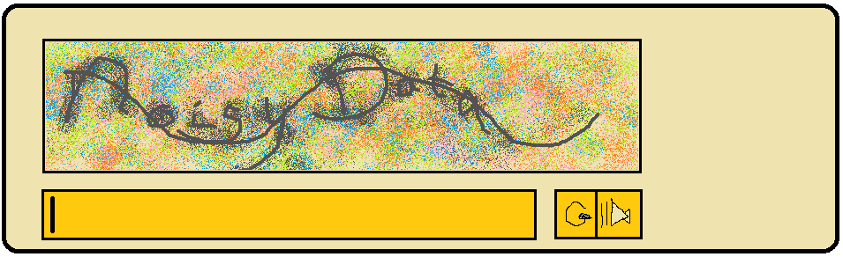
Problem Definition
Problem Definition
Image Processing
EKF SLAM
Graph SLAM
Experiments & Results
Conclusion & F.W.
Real-time simultaneous localization and mapping using the NAO's camera
Landmark detection
Mapping algorithms
Handling noisy data

Slide 4
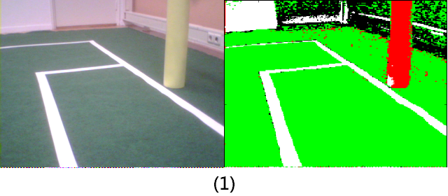
Image Processing
Problem Definition
Image Processing
EKF SLAM
Graph SLAM
Experiments & Results
Conclusion & F.W.
Goal: obtain coordinates of landmarks (goalposts & fieldline cornerpoints)
Prior to new run: take image of grass and goalpost to get interval of the hue of green and yellow
Get average luminence of image
Loop through image and classify pixels as either green, yellow, white or none using the previously calculated bounds for green, yellow and the average luminence (1)

Slide 5
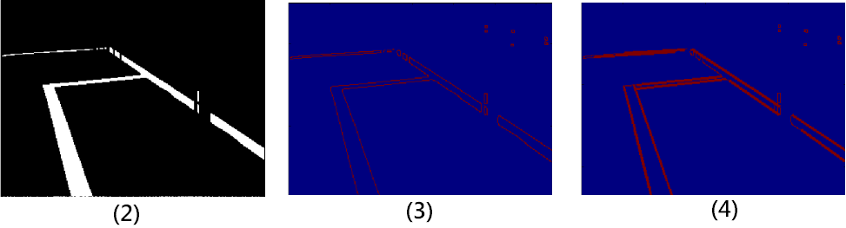
Image Processing (cont.)
Problem Definition
Image Processing
EKF SLAM
Graph SLAM
Experiments & Results
Conclusion & F.W.
Using yellow pixels: extract foot of each goalpost –if any-
Using green pixels: remove background noise (anything outside the field) (2)
OpenCV: edge detection ‘openCV.Canny(...)’ (3)
OpenCV: line detection ‘openCV.HoughLinesP(edges, ...)’ (4)
Loop through lines to find intersections → landmark coordinates
Calculate distance to landmarks

Slide 6
EKF SLAM
Problem Definition
Image Processing
EKF SLAM
Graph SLAM
Experiments & Results
Conclusion & F.W.
Approach to SLAM based on Extended Kalman Filter
Iterative algorithm
Reduce influence of noise by using a series of measurements over time
System state consists of:
  A vector containing estimates of current positions of features
  A matrix containing covariances between features

Slide 7
EKF SLAM – Prediction Step
Problem Definition
Image Processing
EKF SLAM
Graph SLAM
Experiments & Results
Conclusion & F.W.
Predict new state using old state and transition models
Predict new values for covariance using transition models and estimate of noise
  Estimate of noise parameter determined experimentally
Transition Models based on geometric calculations

Slide 8
EKF SLAM – Update Step (1)
Problem Definition
Image Processing
EKF SLAM
Graph SLAM
Experiments & Results
Conclusion & F.W.
Compute Innovation
  Innovation = difference between actual measurement and expected measurement
Compute Kalman Gain
  Matrix of numbers indicating how much we want to gain from the Innovation
  Computed using covariances and estimates of noise
  Tuning noise parameters allows us to trust motion data more than visual measurements...
  ...or other way around

Slide 9
EKF SLAM – Update Step (2)
Problem Definition
Image Processing
EKF SLAM
Graph SLAM
Experiments & Results
Conclusion & F.W.
Update state estimate using Kalman Gain and Innovation
Update covariances using Kalman Gain and Innovation

Slide 10
Graph SLAM
Problem Definition
Problem Definition
Image Processing
Image Processing
EKF SLAM
EKF SLAM
Graph SLAM
Graph SLAM
Experiments
Experiments & Results
Results
Conclusion & F.W.
Conclusion & F.W.
Creates two information matrices: Omega and Xi
Collects three type of constraints:
  Initial position
  Relative motion
  Relative landmark distance

Slide 11
Graph SLAM
Problem Definition
Problem Definition
Image Processing
Image Processing
EKF SLAM
EKF SLAM
Graph SLAM
Graph SLAM
Experiments
Experiments & Results
Results
Conclusion & F.W.
Conclusion & F.W.
Errors are added to Omega and Xi
Best estimates = Omega⁻¹ * Xi

Slide 12
Experiments (1)
Problem Definition
Problem Definition
Image Processing
Image Processing
EKF SLAM
EKF SLAM
Graph SLAM
Graph SLAM
Experiments
Experiments & Results
Results
Conclusion & F.W.
Conclusion & F.W.
Investigate influence of noise
  Compare distance moved to movement command
    Movement commands varying from 20-100 cm
  Compare distance between NAO and landmark to distance computed through Image Processing
    Real distances varying from 80 – 200 cm

Slide 13
Experiments (2)
Problem Definition
Problem Definition
Image Processing
Image Processing
EKF SLAM
EKF SLAM
Graph SLAM
Graph SLAM
Experiments
Experiments & Results
Results
Conclusion & F.W.
Conclusion & F.W.
Results:
  NAO tends to walk in a curve to the left
  NAO tends to walk ~15% too far for the distances tested
  NAO always overestimates distance to landmarks
    Error grows when true distance grows
    More testing required to fit a function to this relation

Slide 14
Experiments (3)
Problem Definition
Image Processing
EKF SLAM
Graph SLAM
Experiments & Results
Conclusion & F.W.
Run SLAM algorithms in simulated world
  Simulated world means easy to run many iterations quickly
Results:
  Accurate maps for both algorithms with correctly tuned parameters

Slide 15
Experiments (4)
Problem Definition
Image Processing
EKF SLAM
Graph SLAM
Experiments & Results
Conclusion & F.W.
Run SLAM algorithms on field with NAO
Results:
  Graph SLAM somewhat accurate map
  EKF SLAM places landmarks and robot outside map boundaries
    Similar errors observed earlier in simulated world when noise parameters were not correctly tuned!

Slide 16
Conclusions & Future Work
Problem Definition
Image Processing
EKF SLAM
Graph SLAM
Experiments & Results
Conclusion & F.W.
More time-steps per experiment needed to reduce noise
More experiments needed to better tune noise parameters

